Slide 1
PHISHING AWARENESS
Recognition and avoidance
By Vishal Bansal

Slide 2
Contents
Introduction to Phishing
Common Phishing Tactics
Recognizing Phishing Emails
Identifying Phishing websites
Social Engineering Tactics
Reporting Phishing Attempts
Preventive Measures
Security Best Practices
Conclusion

Slide 3
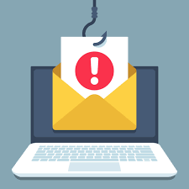
Introduction to Phishing
Phishing is a type of social engineering attack where criminals use deceptive tactics to trick victims into revealing sensitive information or performing actions that compromise their security. This can include stealing login credentials, financial information, or installing malware on their devices.

Slide 4
Common Phishing Tactics
Fake Emails
Phishers often send emails that appear to be from legitimate organizations, like banks or government agencies, to lure victims into clicking on malicious links or providing personal information.
Fraudulent Websites
Phishers create fake websites that closely resemble real ones to steal login credentials or financial information from unsuspecting users.
Urgent Calls to Action
Phishing messages often create a sense of urgency, pressuring victims to act quickly without thinking through the consequences.

Slide 5
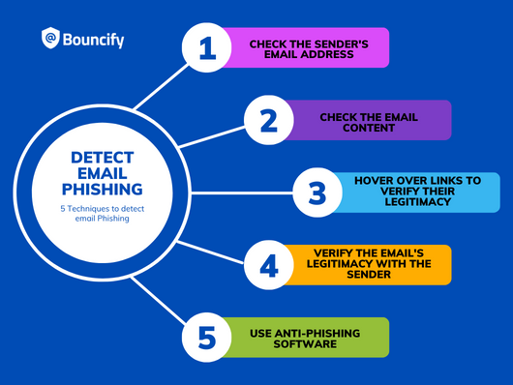
Recognizing Phishing Emails
Suspicious Links
Hover over links to check if the URL matches the claimed destination. Avoid clicking on suspicious links.
Sender Email Address
Look for strange or generic email addresses that don't match the organization they claim to be from.
Inconsistent Branding
Phishing emails often have poor formatting, spelling errors, or use of branding that doesn't match the real organization.

Slide 6
Identifying Phishing Websites
Lack of HTTPS : Legitimate websites should have a secure "https://" prefix in the URL.
Missing SSL Certificate : Phishing sites often lack a valid SSL certificate to encrypt user data.
Suspicious Domain : Watch for misspelled domain names or unusual top-level domains (e.g.,".xyz").
Unsecured Login Forms : Phishing sites may have login pages that are not properly secured.

Slide 7
Social Engineering Tactics
Stay Vigilant : Be aware of your surroundings and the people you interact with, both online and offline.
Stay Vigilant : Be aware of your surroundings and the people you interact with, both online and offline.
Continuous Education : Stay informed about the latest phishing techniques and train employees to identify and report suspicious activities.

Slide 8
Reporting Phishing Attempts
Identify the Phishing Attempt : Carefully examine the email, website, or communication to determine if it's a phishing attack.
Internal Reporting Procedures : Provide guidelines for reporting phishing attempts to the organization, including whom to contact and what information to provide.
Reporting to External Authorities : Encouraging reporting phishing attempts to external organizations such as CERT/CSIRT or anti-phishing organizations for further investigation and action.

Slide 9
Preventive Measures
Educate Yourself : Stay informed about the latest phishing tactics and techniques to recognize and avoid them.
Verify Legitimacy : Confirm the authenticity of any suspicious communication before providing any sensitive information.
Use Security Tools : Utilize anti-virus software, email filters, and other security measures to detect and block phishing attempts.
Report Incidents : Promptly report any suspected phishing attempts to the relevant authorities to help prevent future attacks.

Slide 10
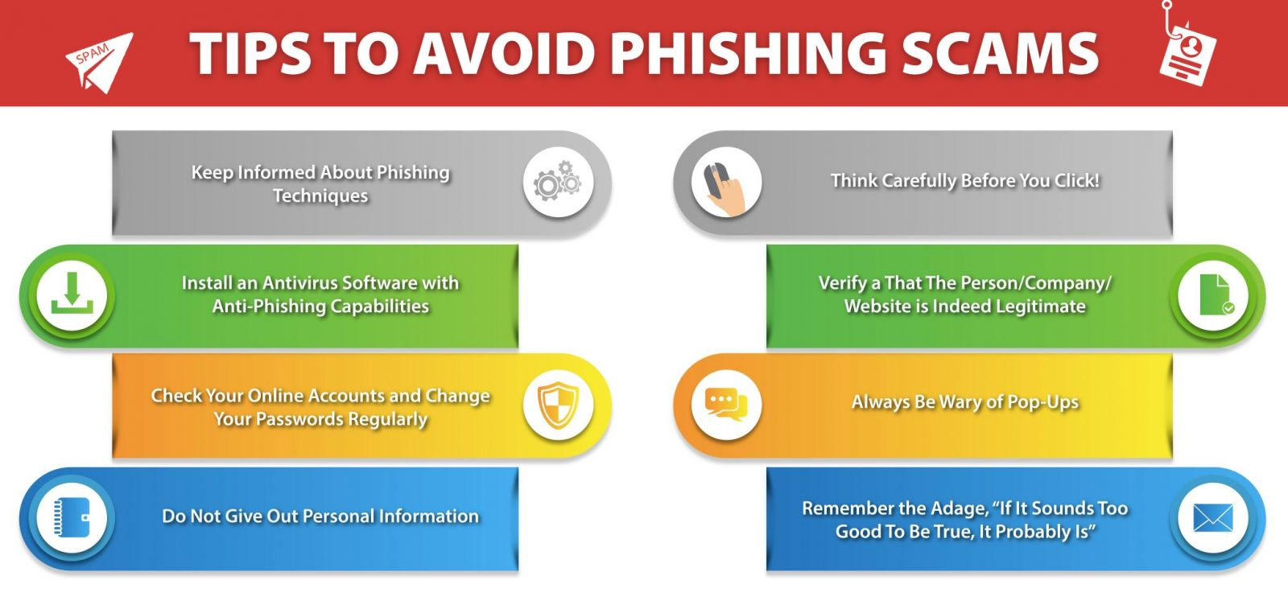
Security Best Practices
Enable a two-factor authentication for enhanced account security.
Keep software and systems updated to patch known vulnerabilities.
Use strong, unique passwords and password managers to store credentials securely.
Verify requests for sensitive information by contacting the sender through truster channels.

Slide 11
Conclusion
Phishing Remains a Persistent Threat : Phishing attacks continue to evolve, so it's crucial to stay informed and vigilant to protect yourself and your organization.
Develop a Phishing-Resistant Culture : Educating employees about phishing and fostering a culture of cybersecurity awareness can significantly reduce the risk of successful attacks.
Stay Proactive and Responsive : By recognizing phishing attempts, reporting incidents, and continuously improving security measures, we can work together to combat this persistent threat.

Slide 12


